Slide 1



Agentic Corrective RAG for Indian Judgement Legal Document Segmentation
NLP Project Review
LEGAL NLP
AGENTIC RAG
INDIAN JUDICIARY

Slide 2

Problem Statement
Naive RAG systems chunk legal documents by arbitrary token length, destroying the rhetorical structure of a judgment — Facts, Issues, Arguments, Precedents, Ratio Decidendi.
When irrelevant chunks are retrieved, LLMs confidently hallucinate incorrect legal answers.
Our Goal
Build a RAG pipeline that:
Understands the rhetorical roles inside Indian legal judgments
Actively checks and corrects its own retrievals before generating an answer
Does not blindly trust the vector search results
Blind trust in vector search leads to hallucinated legal answers — a critical failure in high-stakes contexts.

Slide 3
Dataset
InLegalBERT Pretraining Corpus
LegalSeg Dataset
Nigam et al., NAACL 2025 — 7,120 documents, 1.4 million sentences, labeled with 7 rhetorical roles: Facts, Issues, Arguments of Petitioner, Arguments of Respondent, Reasoning, Decision, None. Largest annotated dataset for this task; used to fine-tune the segmentation head.
5.4 million Indian Supreme Court and High Court judgments (1950–2019), approximately 27 GB raw text. Used to obtain a legal-domain-aware base model.

Slide 4
Research Gap & Proposed Solution
The Research Gap
Proposed Solution
Legal segmentation research (InLegalBERT, LegalSeg) and Corrective RAG research (CRAG) exist as two separate literatures. No prior work fuses rhetorical-role-aware chunking with a self-correcting agentic retrieval loop for Indian legal text. Standard RAG has no built-in mechanism to detect when retrieval itself has failed.
1
Phase 1 — Segmentation
Fine-tune InLegalBERT as a token-classification head to segment judgments into 7 rhetorical roles; store role-tagged chunks in ChromaDB, filterable by role.
2
Phase 2 — Agentic Correction
Wrap retrieval in a LangGraph state machine where a lightweight LLM (Llama-3.2-3B-Instruct via Ollama) grades every retrieved chunk as Correct, Ambiguous, or Incorrect and routes accordingly.

Slide 5
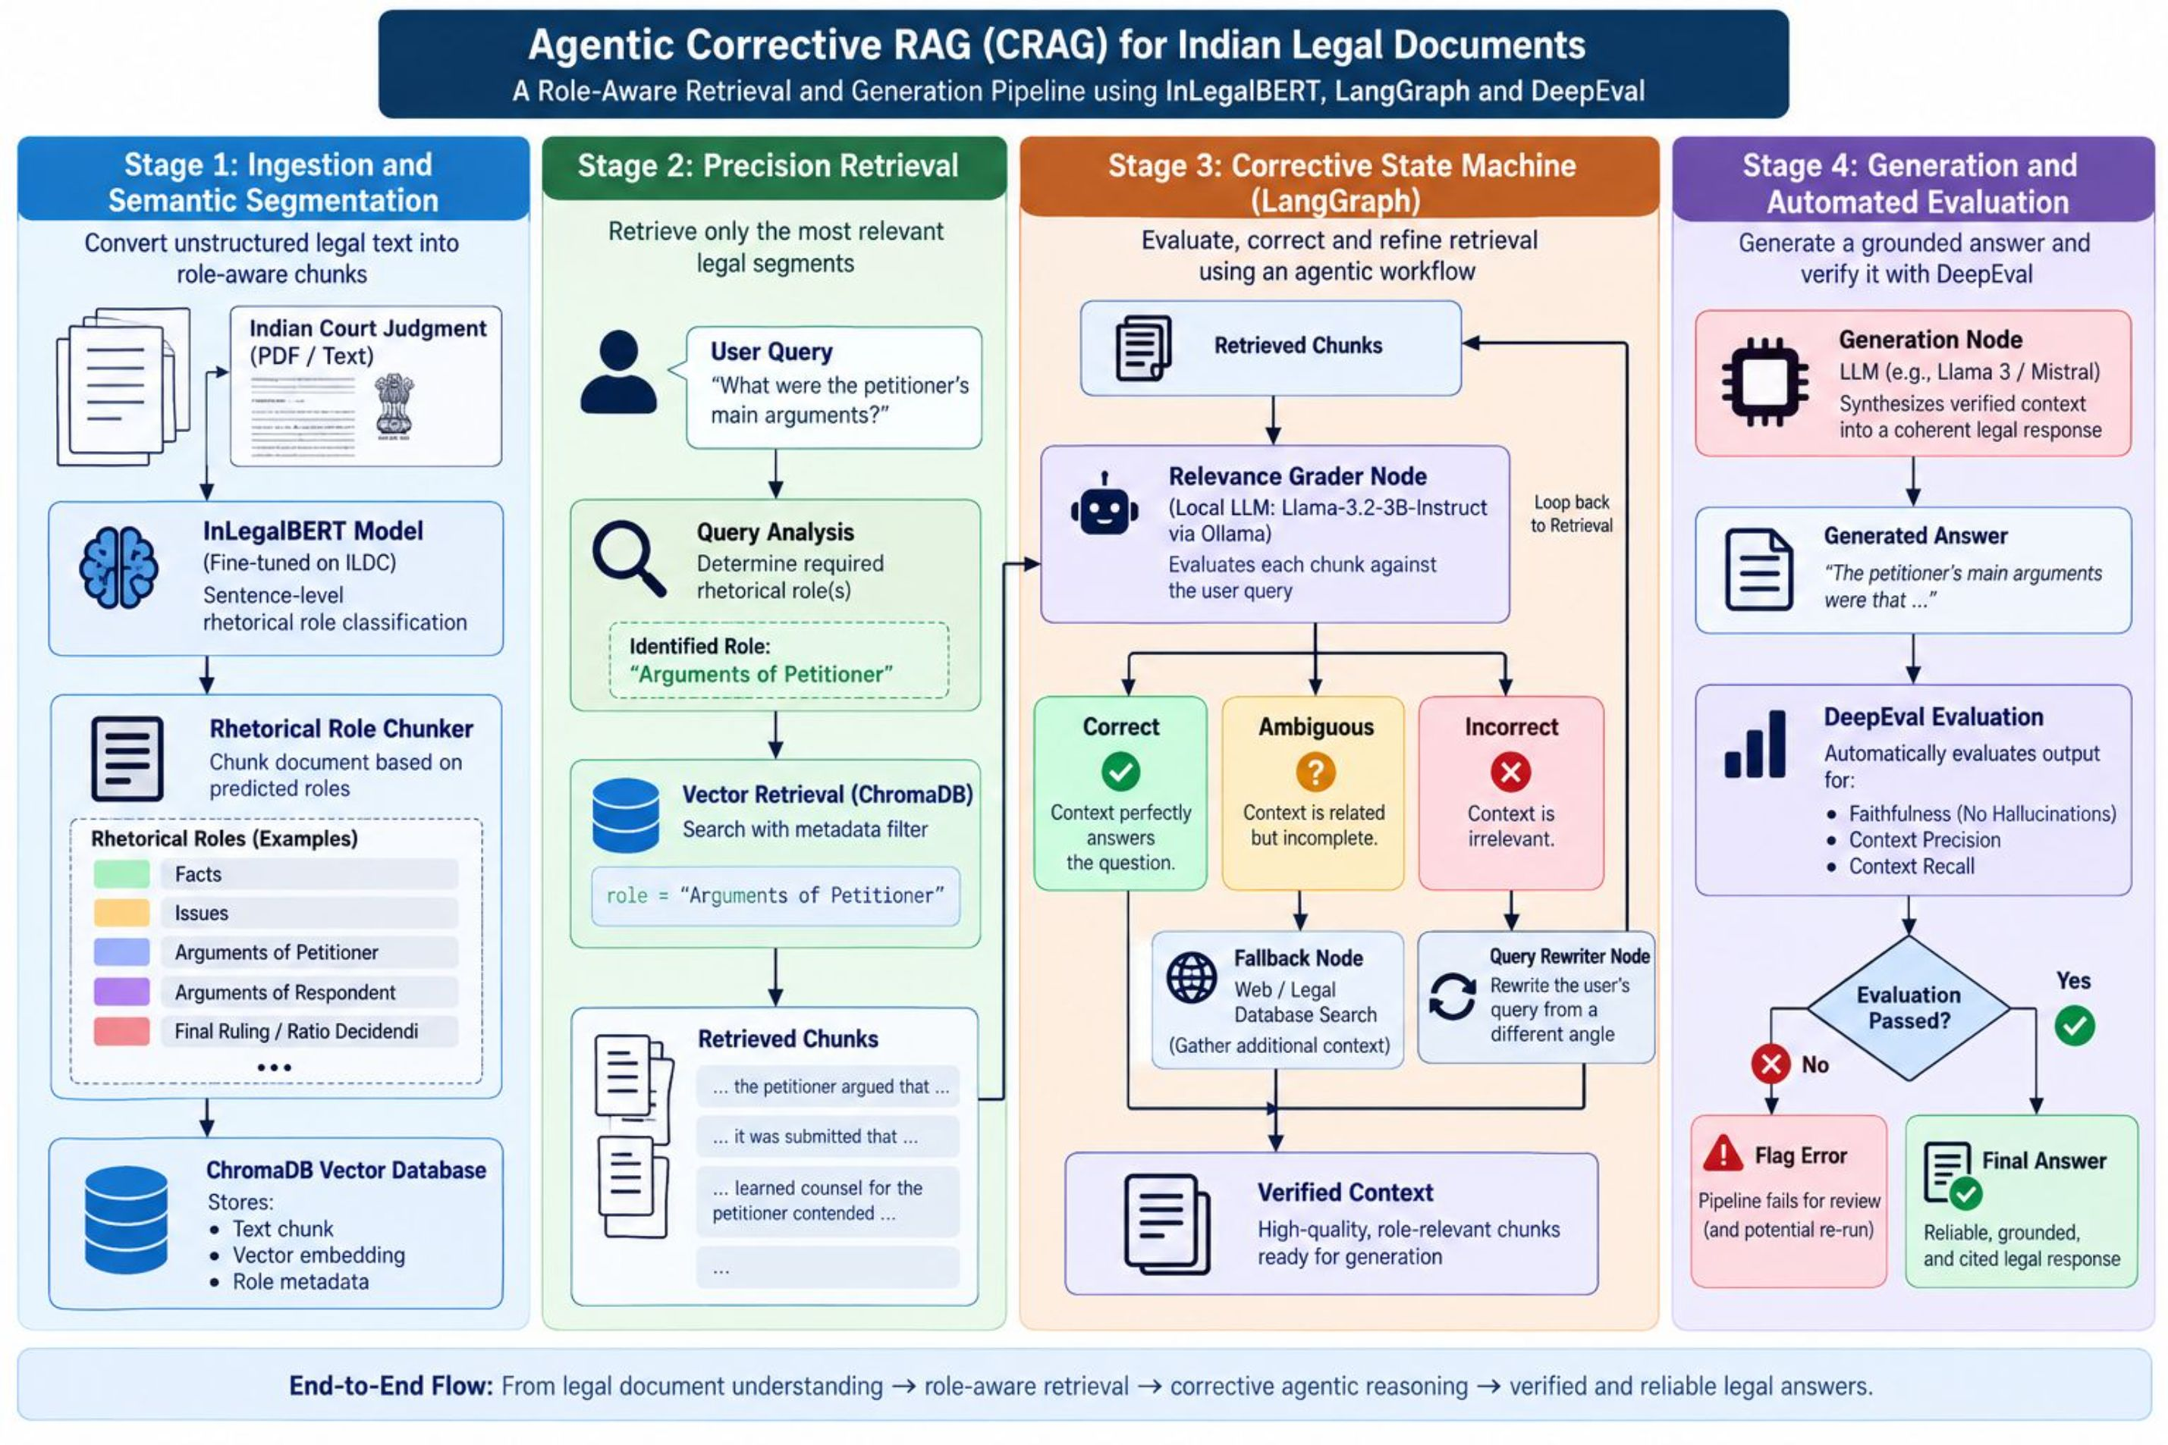
System Workflow

Slide 6

Sample Input & Output
Query
What did the petitioner argue regarding the limitation period in this case?
Retrieval Trace
Generated Output
Retrieval Node pulls chunks tagged ARG_PETITIONER only. Three chunks retrieved:
The petitioner argued that the suit was filed within the limitation period under Section 27 of the Limitation Act, contending that the cause of action arose only upon the respondent's refusal to hand over possession on the specified date, not from the original agreement date.
Correct — score 0.85
Ambiguous — score 0.50
Incorrect — score 0.15 (discarded)
A Correct chunk exists, so the system extracts the knowledge strip and skips the fallback search.
Faithfulness check: claim cross-referenced against the retrieved chunk — passed with a score of 1.0.

Slide 7
Conclusion
This project fuses rhetorical-role-aware legal document segmentation with a self-correcting agentic RAG pipeline, closing a gap between two separate research areas.
🔗 Bridging Two Fields
🛡️ Reduced Hallucination
✅ Test-Driven Faithfulness
Unifies legal segmentation research and Corrective RAG into a single, coherent pipeline for Indian legal text.
The system reduces hallucination risk in legal question answering by grading and correcting retrieval before generation.
Every output is validated against a rigorous, test-driven faithfulness metric rather than trusted blindly, making the pipeline suitable for high-stakes legal use cases.

Slide 8
Literature Foundation
Bhattacharya et al. — JURIX 2019
1
Identification of Rhetorical Roles: defined the original 7-role schema for Indian legal judgments.
2
Lewis et al. — NeurIPS 2020
Retrieval-Augmented Generation: foundational RAG architecture that this project builds upon.
Paul, Mandal, Ghosh, Ghosh — 2022
3
InLegalBERT: domain-adapted transformer pretrained on 5.4 million Indian legal documents.
4
Es et al. — 2023
RAGAS: defines the Faithfulness, Answer Relevance, and Context Relevance triad that DeepEval operationalizes.
Yan et al. — 2024
5
Corrective Retrieval Augmented Generation (CRAG): the retrieval evaluator and correction loop this project adapts.
6
Nigam et al. — NAACL 2025
LegalSeg: largest rhetorical role dataset for Indian judgments, central to this project's fine-tuning.

